Slide 1
Advanced Programming – Part II
K.N.Toosi
Instructor: Maryam Abdolali
Spring 2023

Slide 2
Lambda
What?
A lambda function is a small anonymous function. No name function!
A lambda function can take any number of arguments, but can only have one expression.
Syntax
lambda arguments : expression
Lambda vs Def
add_one = lambda x: x + 1
add_one(2)
The above lambda function is equivalent to writing this:
def add_one(x):
return x + 1

Slide 3
Lambda
>>> lambda x: x
the expression is composed of:
The keyword: lambda
A bound variable: x
A body: x
In a lambda function, statements like return, pass, assert, will raise a SyntaxError exception.
in the definition of the lambdas, the arguments don’t have parentheses around them. Multi-argument functions are expressed in Python lambdas by listing arguments and separating them with a comma (,) but without surrounding them with parentheses:
>>> full_name = lambda first, last: f”Full name: {first.title()} {last.title()}”
>>> full_name(‘maryam’, ‘abdolali’)

Slide 4
Examples of lambda
No arguments:
greet = lambda : print('Hello World')
greet( )
With a single argument:
greet_user = lambda name : print('Hey there ', name)
greet_user('Maryam’)
Or….
(lambda name : print('Hey there ', name))("Maryam")
What happens in this example?
def myfunc(n):
return lambda x : x * n
mydoubler = myfunc(2)
mytripler = myfunc(3)
print(mydoubler(11))
print(mytripler(11))

Slide 5
Be careful!
funcs = [ ]
for x in [1,2,3]:
funcs.append(lambda: x)
for f in funcs:
print(f( ))
Note that lambda captured the variable x, not its value at the time of creation.
A "trick" that can be seen often in Python when capturing the value is the desired semantic is to use default arguments. In Python, default value expressions are evaluated at function definition time (i.e. when the lambda is created) and not when the function is invoked.
funcs = []
for x in [1,2,3]:
funcs.append(lambda x=x: x)
for f in funcs:
print(f( ))

Slide 6
Yet another example!
def foo(x):
a = lambda: x
x = 7
b = lambda: x
return a,b
a,b=foo(4)
print(a( ))
print(b( ))
Why?
because the x is directly bound to the lambda not its value!

Slide 7
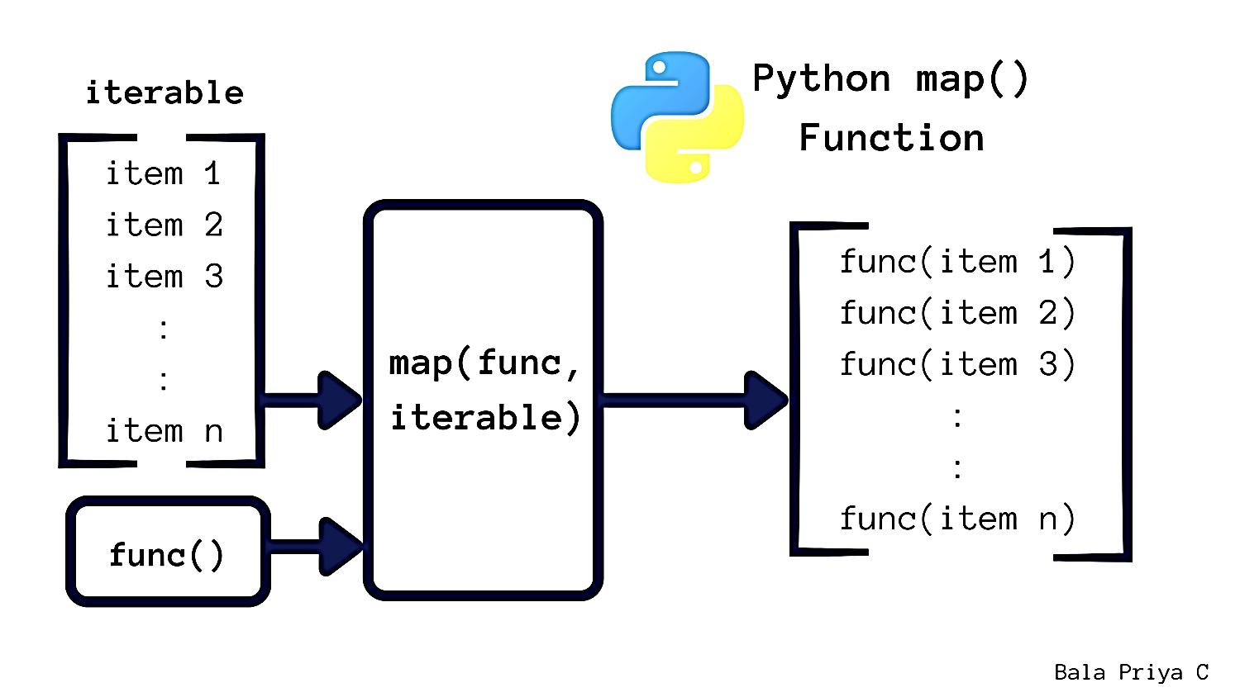
Map
The map function iterates through all items in the given iterable and executes the function we passed as an argument on each of them.
Syntax:
map(function, iterable(s))

Slide 8
Why Map?
Since map() is written in C and is highly optimized, its internal implied loop can be more efficient than a regular Python for loop.
A second advantage of using map() is related to memory consumption. With a for loop, you need to store the whole list in your system’s memory. With map(), you get items on demand, and only one item is in your system’s memory at a given time.

Slide 9
Example suppose you need to take a list of numeric values and transform it into a list containing the square value of every number in the original list.
Traditional
Using map
numbers = [1, 2, 3, 4, 5]
squared = [ ]
for num in numbers:
squared.append(num ** 2)
def square(number):
return number ** 2
numbers = [1, 2, 3, 4, 5]
squared = list(map(square, numbers))

Slide 10
Examples
Convert all the items in a list from a string to an integer number.
Convert all the items in a string list to upper case
str_nums = ["4", "8", "6", "5", "3", "2"]
int_nums = map(int, str_nums)
my_pets = ['alfred', 'tabitha', 'william', 'arla']
uppered_pets = map(str.upper, my_pets)

Slide 11
Map with lambda
Remove dots from string items
Transform a list containing the square value of every number in the original list
numbers = [1, 2, 3, 4, 5]
squared = map(lambda num: num ** 2, numbers)
with_dots = ["processing..", "...strings", "with....", "..map.."]
list(map(lambda s: s.strip("."), with_dots))

Slide 12
Map with multiple input iterables
Elementwise power
Elementwise addition
first_it = [1, 2, 3]
second_it = [4, 5, 6, 7]
list(map(pow, first_it, second_it))
z = list(map(lambda x, y: x + y, [2, 4, 6], [1, 3, 5]))

Slide 13
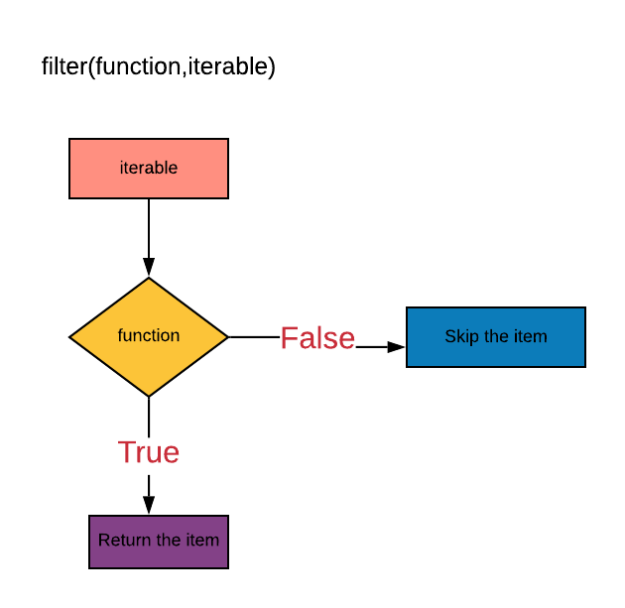
Filter
The filter function returns an iterator were the items are filtered through a function to test if the item is accepted or not.
Syntax:
filter(function, iterable)

Slide 14
Example Extract positive numbers
Traditional
Using filter & lambda
Using filter & def
numbers = [-2, -1, 0, 1, 2]
def extract_positive(numbers):
positive_numbers = [ ]
for number in numbers:
if number > 0: # Filtering condition
positive_numbers.append(number)
return positive_numbers
pos = extract_positive(numbers)
numbers = [-2, -1, 0, 1, 2]
# Using a lambda function
positive_numbers = filter(lambda n: n > 0, numbers)
pos = list(positive_numbers)
numbers = [-2, -1, 0, 1, 2]
# Using a user-defined function
def is_positive(n):
return n > 0
pos = list(filter(is_positive, numbers))

Slide 15
Example
Squaring the even numbers in a list
numbers = [1, 3, 10, 45, 6, 50]
def is_even(number):
return number % 2 == 0
even_numbers = list(filter(is_even, numbers))
sqrt = list(map(lambda n: n ** 2, even_numbers))
sqrt_2 = list(map(lambda n: n ** 2, filter(is_even, numbers)))

Slide 16
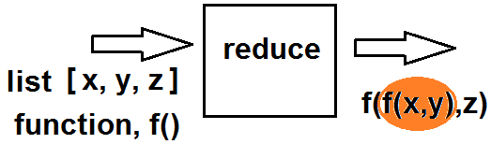
Reduce
The idea behind Python’s reduce() is to take an existing function, apply it cumulatively to all the items in an iterable, and generate a single final value.
Syntax
from functools import reduce
reduce(function, iterable)

Slide 17
Example: sum of items in a list
Traditional
Using reduce & lambda
numbers = [1, 2, 3, 4]
total = 0
for num in numbers:
total += num
from functools import reduce
numbers = [1, 2, 3, 4]
reduce(lambda a, b: a + b, numbers)

Slide 18
Example
Finding min & max
Using lambda
from functools import reduce
# Minimum
def my_min_func(a, b):
return a if a < b else b
# Maximum
def my_max_func(a, b):
return a if a > b else b
numbers = [3, 5, 2, 4, 7, 1]
reduce(my_min_func, numbers)
reduce(my_max_func, numbers)
from functools import reduce
numbers = [3, 5, 2, 4, 7, 1]
# Minimum
reduce(lambda a, b: a if a < b else b, numbers)
# Maximum
reduce(lambda a, b: a if a > b else b, numbers)

Slide 19

List Comprehensions
List comprehension in Python is an easy and compact syntax for creating a list from a string or another list.
It is a very concise way to create a new list by performing an operation on each item in the existing list.
List comprehension is considerably faster than processing a list using the for loop.
new_list = [expression for element in iterable if condition]

Slide 20
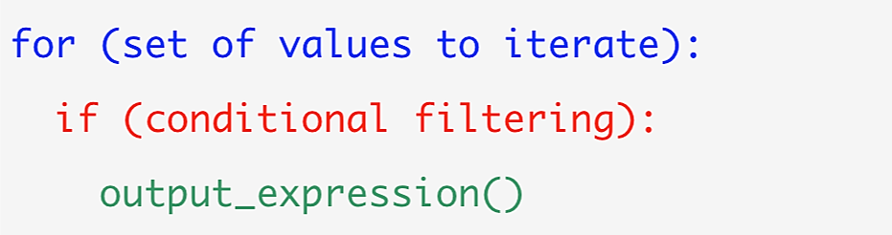
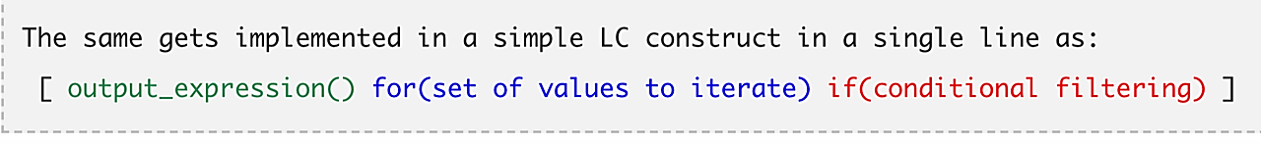
Visual explanation
Traditional for loop
List comprehension way

Slide 21
Examples
Even numbers
Matrix using List comprehension
list = [i for i in range(11) if i % 2 == 0]
print(list)
matrix = [[j for j in range(3)] for i in range(2)]
print(matrix)

Slide 22
Conditionals in List Comprehension
Example 1
Example 2
lis = ["Even number" if i % 2 == 0
else "Odd number" for i in range(8)]
print(lis)
lis = [num for num in range(100)
if num % 5 == 0 if num % 10 == 0]
print(lis)

Slide 23
More complex example: finding transpose
Consider a 3×3 matrix represented by a list of lists:
M = [[1,2,3],
[4,5,6],
[7,8,9]]
Without using list comprehension, the transpose of this matrix could be built up by looping over the rows and columns:
MT = [[0,0,0], [0,0,0], [0,0,0]]
for r in range(3):
for c in range(3):
MT[c][r] = M[r][c]

Slide 24
-cont- Matrix transpose
With one list comprehension, the transpose can be constructed as:
MT = []
for c in range(3):
MT.append([M[r][c] for r in range(3)])
The outer loop here can be expressed as a list comprehension of its own:
MT=[[M[r][c] for r in range(3)] for c in range(3)]
See “list comprehension lab” for more examples!
Notes:
MT = [ ]
for i in range(3):
MT.append([row[i] for row in M])
MT = [[row[i] for row in M] for i in range(3)]

Slide 25

Expecting the Unexpected!
Programs are very fragile.
It would be ideal if code always returned a valid result, but sometimes a valid result can't be calculated.
For example, it's not possible to divide by zero, or to access the eighth item in a five-item list.
Examples:
print "hello world"
SyntaxError: invalid syntax
x = 5 / 0
ZeroDivisionError: int division or modulo by zero
lst = [1,2,3]
print(lst[3])
IndexError: list index out of range

Slide 26
AttributeError: 'list' object has no attribute 'add’
TypeError: can only concatenate list (not "int") to list
KeyError: 'b’
NameError: name 'this_is_not_a_var' is not defined
Sometimes these exceptions are indicators of something wrong in our program (in which case we would go to the indicated line number and fix it), but they also occur in legitimate situations.
In principle, an exception is just an object.
There are many different exception classes available (and we can easily define more of our own).
The one thing they all have in common is that they inherit from a built-in class called BaseException.

Slide 27
The effects of an exception
When an exception is raised, it appears to stop program execution immediately.
Any lines that were supposed to run after the exception is raised are not executed,
Unless the exception is dealt with, the program will exit with an error message.
def no_return():
print("I am about to raise an exception")
1/0 #raise Exception("This is always raised")
print("This line will never execute")
return "I won't be returned"

Slide 28
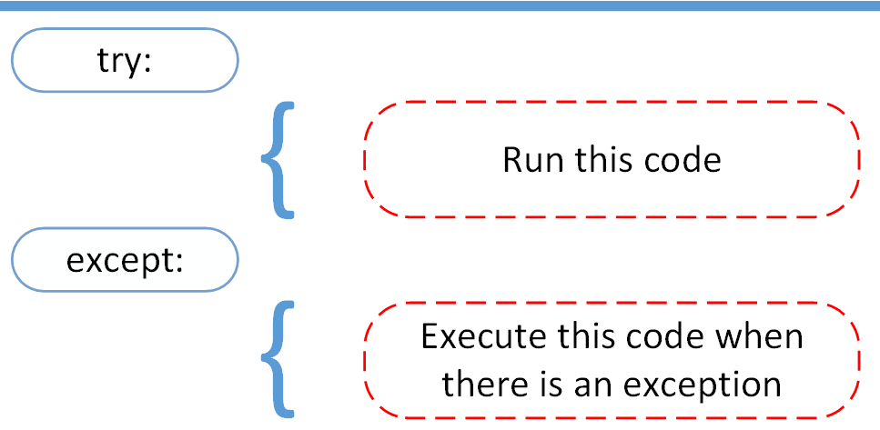
Handling exceptions
We handle exceptions by wrapping any code that might throw one (whether it is exception code itself, or a call to any function or method that may have an exception raised inside it) inside a “try...except” clause.
try:
no_return()
except:
print("I caught an exception")
print("executed after the exception")
Note:
it will catch any type of exception
The remainder of the code in the no_return function still went unexecuted, but the code that called the function was able to recover and continue.

Slide 29
Catch specific type of exception
def funny_division(divider):
try:
return 100 / divider
except ZeroDivisionError:
return "Zero is not a good idea!"
print(funny_division(0))
print(funny_division(50.0))
print(funny_division("hello"))
def funny_division2(anumber):
try:
return 100 / anumber
except (ZeroDivisionError, TypeError):
return "Enter a number other than zero"

Slide 30
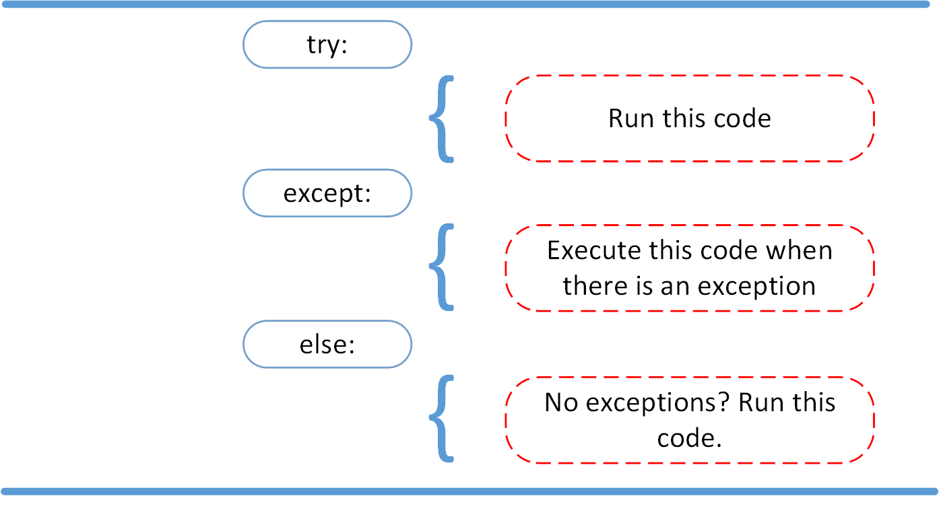
More complex exception handling
Practical example
text = []
try:
fh = open(file_name, 'r')
except IOError:
print('cannot open', file_name)
else:
text = fh.readlines()
fh.close()
if text:
print(text)

Slide 31
Practical example
reading an integer from input:
while True:
try:
n = input("Please enter an integer: ")
n = int(n)
break
except ValueError:
print("No valid integer! Please try again ...")
print("Great, you successfully entered an integer!")
def read_integer():
while True:
try:
input_str = input("Please type in an integer: ")
return int(input_str)
except ValueError:
print("This input is invalid")
number = read_integer()
print("Thank you!")
print(number, "to the power of three is", number**3)

Slide 32
Raising an exception
what we should do if we're writing a program that needs to inform the user or a calling function that the inputs are somehow invalid.
class EvenOnly(list):
def append(self, integer):
if not isinstance(integer, int):
raise TypeError("Only integers can be added")
if integer % 2:
raise ValueError("Only even numbers can be added")
super().append(integer)

Slide 33
Defining our own exceptions
All we have to do is inherit from the Exception class. We don't even have to add any content to the class! We can, of course, extend BaseException directly, but then it will not be caught by generic except Exception clauses.
Here's a simple exception we might use in a banking application:
class InvalidWithdrawal(Exception):
pass
raise InvalidWithdrawal("You don't have $50 in your account")

